Slide 1
Multi container
Hwo to host multi container in one ACI

Slide 2
Steps
Best done on azure cli
Install azure cli
Create a resource group
Create a deployment file(yaml)
Create the container according to the file
Inspect the functionalities

Slide 3
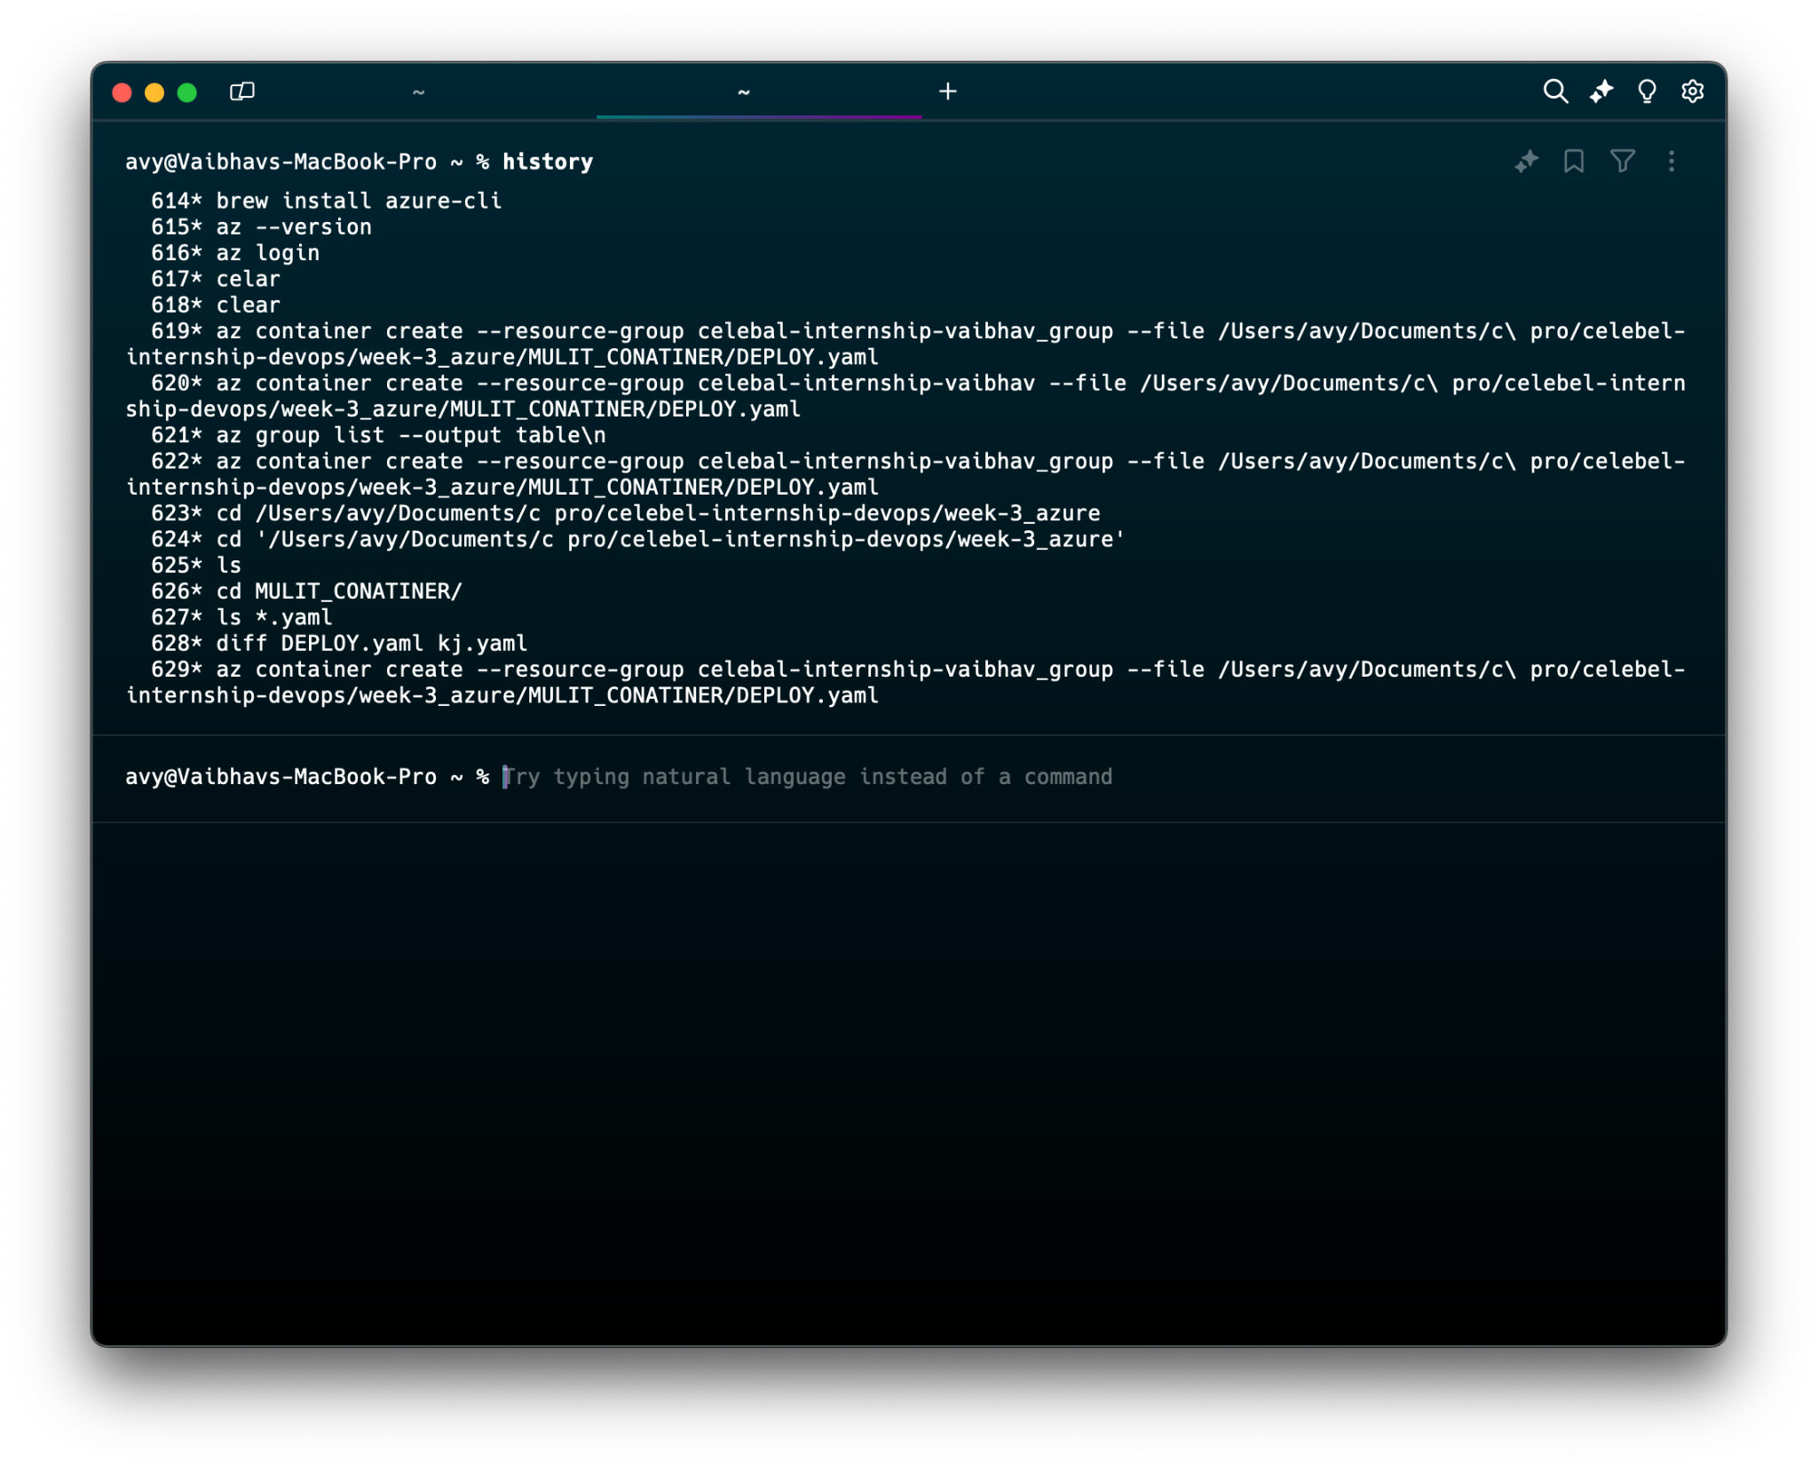

Slide 4
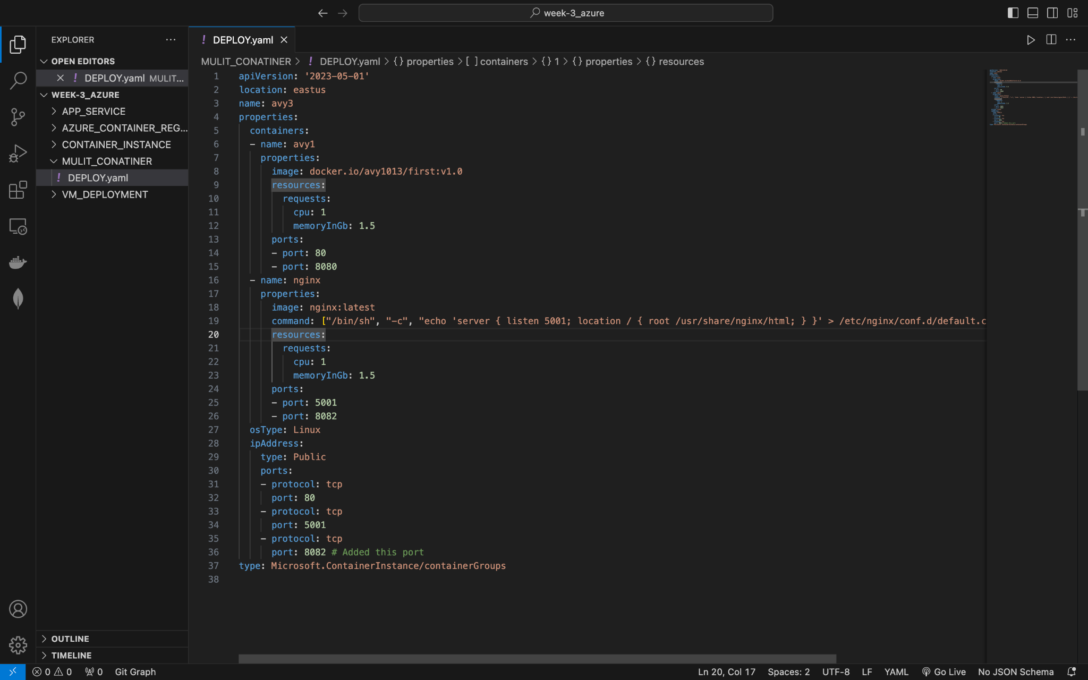

Slide 5
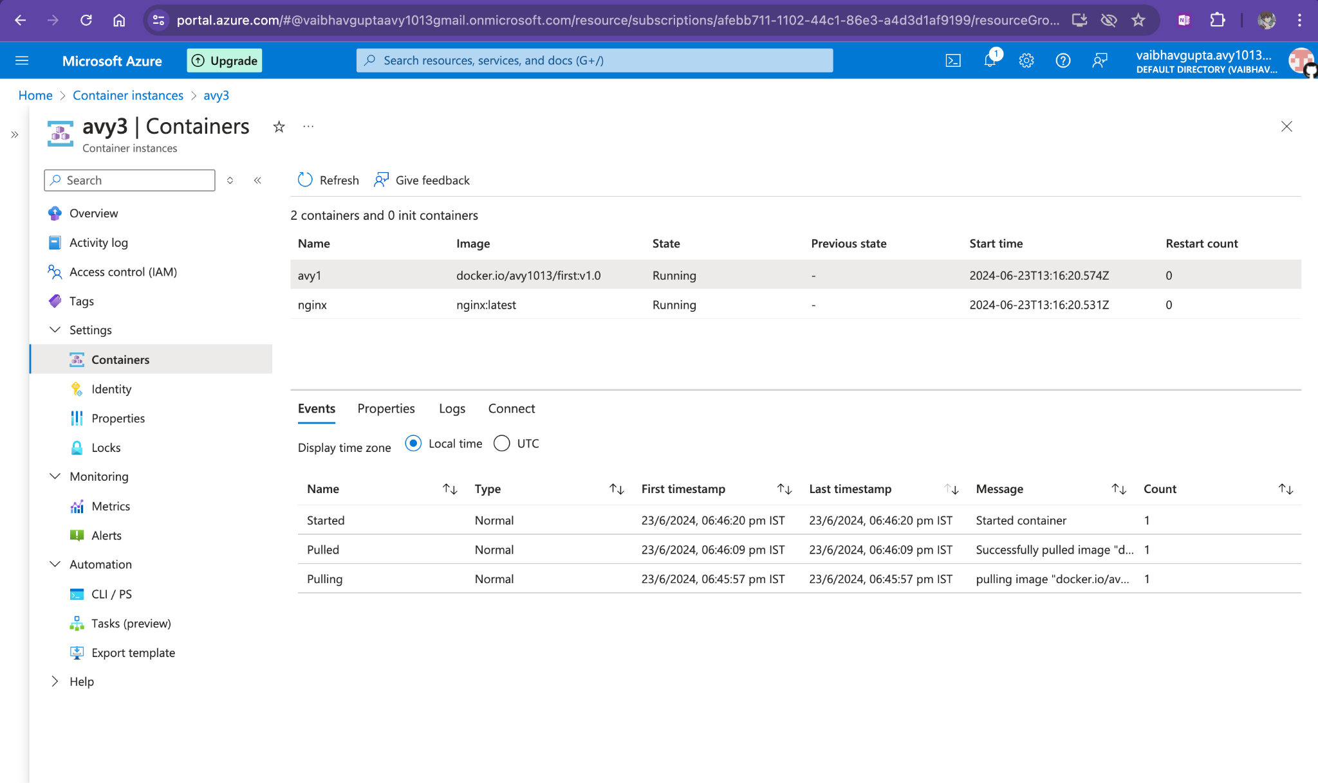
Two containers are running

Slide 6
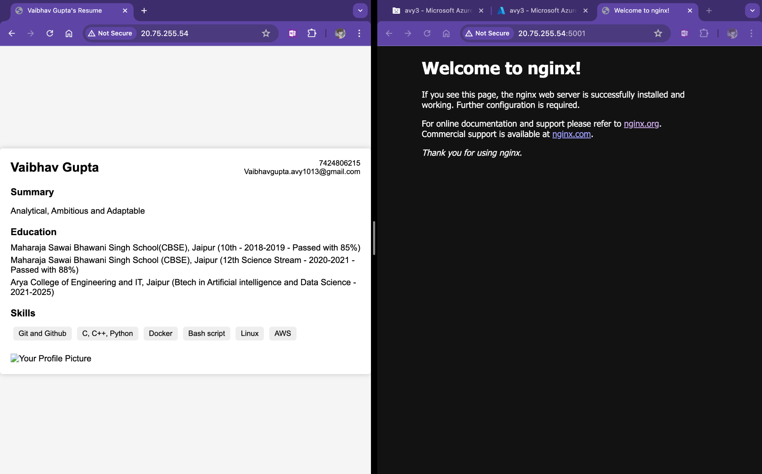
Two container deployed on same ip with different ports on same container instance

